Slide 1


Project Title: Store sales dataset
Graduation Project.Depi G6
By Omar Loay

Slide 2
Our Team: Introducing the 6 Members and Their Contributions
1
Basma Osama Ahmed (Team leader)
2
Sohaila Ayman
Cleaning/Visuals
Cleaning/Visuals
3
Sohaila Mohamed Kasem
4
Aser Mohamed
ERD diagram/data Schema
SQL code to create tables
5
Menna Elgazar
6
Omar Loay Salah Soliman
Exploring data using python
presentation/documentation notebook

Slide 3
Data Insights: Overview of Extracted Information from the Analysis
Dataset overview
Key Observations
Total Rows : 1798 Rows
Total columns : 21 Columns
Data types : Integer, Object, Float and DateTime.
. Integer: (2) Columns.
. Object : (14) Columns.
. Float: (3) Columns
. Date : (2) Columns
. Memory usage: 309.0+ KB
.The dataset contains no missing values (Non-Null Count is 1798 for all columns).
.Most columns are categorical (Object), with a few numerical (Integer,Float) and Date columns.

Slide 4

Data Processing: Step-by-step Implementation
1
Step 1: Data Exploration
In Data Exploration, we analyze and summarize the dataset to understand its structure, patterns, and potential issues.
This includes:
Checking Data Types, Handling Missing Values and Statistical Summary.
2
Step 2: Data Cleaning
In Data Cleaning, we improve data quality by fixing errors and inconsistencies. This includes:
Handling Missing Data, Removing Duplicates, Correcting Errors and Handling Outliers.
3
Step 3: ERD diagram, Data Schema and SQL code to create tables
In SQL code to create tables-> we define the structure of a database table using the CREATE TABLE statement.
This includes:
Specifying Table Name, Defining Columns & Data Types, Adding Constraints and Setting Default Values.

Slide 5
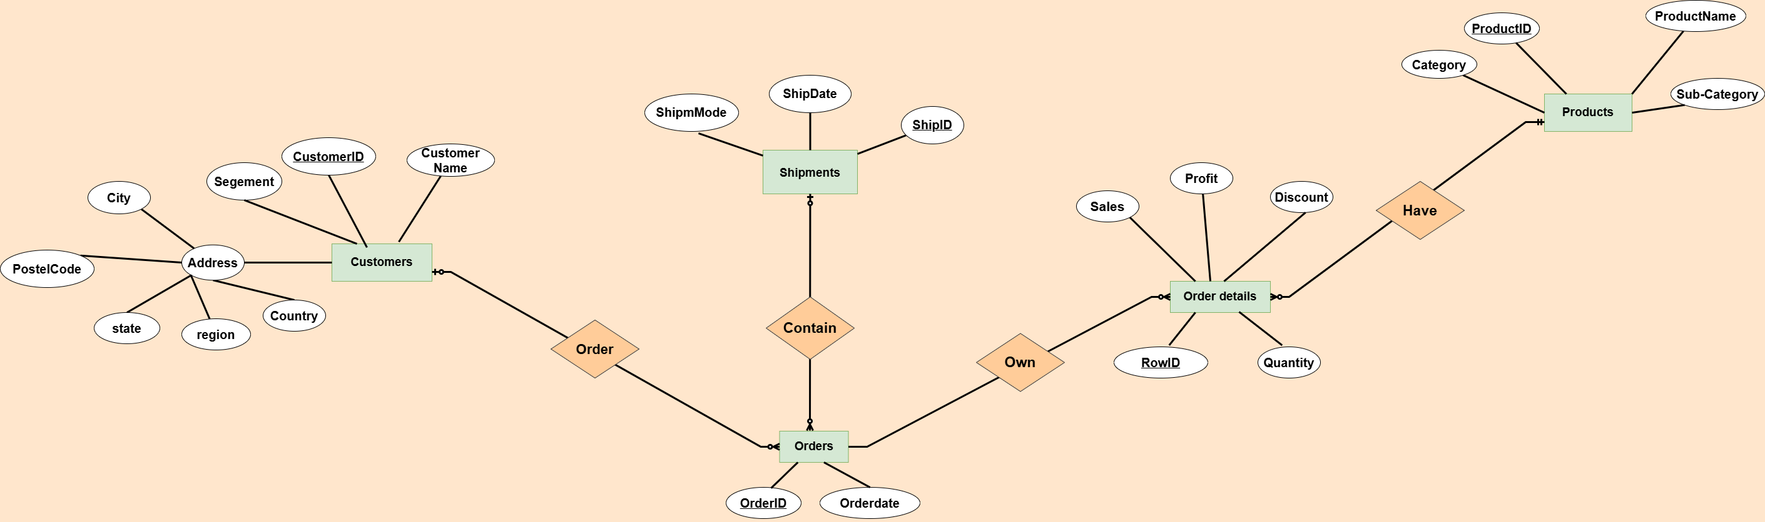
ERD diagram

Slide 6
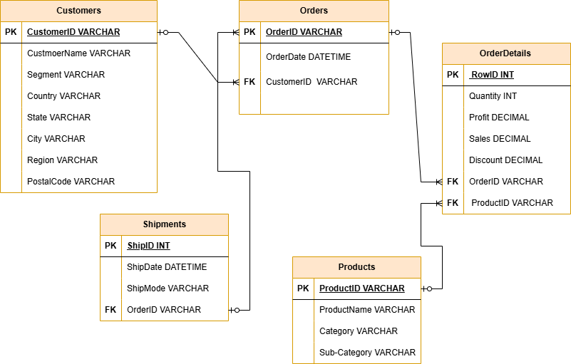
Data Schema

Slide 7
-- Table for Customers
CREATE TABLE Customers ( CustomerID VARCHAR(255) PRIMARY KEY, CustmoerName VARCHAR(255),Segment VARCHAR(255), Country VARCHAR(255), State VARCHAR(255), City VARCHAR(255), Region VARCHAR(255), PostalCode VARCHAR(255));
-- Table for Orders
CREATE TABLE Orders ( OrderID VARCHAR(255) PRIMARY KEY, OrderDate DATETIME, CustomerID VARCHAR(255), FOREIGN KEY (CustomerID) REFERENCES Customers(CustomerID));
-- Table for OrderDetails
CREATE TABLE OrderDetails( RowID INT PRIMARY KEY, Quantity INT, Profit DECIMAL, Sales DECIMAL, Discount DECIMAL, OrderID VARCHAR(255), ProductID VARCHAR(255), FOREIGN KEY (ProductID) REFERENCES Products(ProductID), FOREIGN KEY (OrderID) REFERENCES Orders(OrderID));
-- Table for Products
CREATE TABLE Products( ProductID VARCHAR(255) PRIMARY KEY, ProductName VARCHAR(255), Category VARCHAR(255), Sub-Category VARCHAR(255));
-- Table for Shipments
CREATE TABLE Shipments( ShipID INT PRIMARY KEY, ShipDate DATETIME,ShipMode VARCHAR(255), OrderID VARCHAR(255), FOREIGN KEY (OrderID) REFERENCES Orders(OrderID));
SQL Code

Slide 8
SQL Questions -> For Relational Analysis & Aggregation
1. Sales & Profit Analysis
What is the total sales and profit per year?
Which Customer has made the highest total purchases?
Which product category generates the most revenue?
2. Shipping & Delivery Insights
What is the average shipping time(difference between OrderDate and ShipDate) for each Ship mode?
Which region has the fastest and slowest average shipping times?
How many orders were shipped using each Ship mode?
3.Customers & Location Trends
What are the top 5 cities with the highest number of orders?
Which state has the highest total profit?
What percentage of customers belong to each segment (Consumer, Corporate and Home Office)?

Slide 9
What is the total sales and profit per year?
Which state has the highest total profit?
Select YEAR(o.OrderDate) As Year,
SUM(od.Sales) AS Total_Sales,
SUM(od.Profit) AS Total_Profit
From Orders o
Join OrderDetails od ON o.OrderID = od.OrderID
Group By YEAR(o.OrderDate)
Order By Year;
Select c.State, Sum(od.Profit) As Total_Profit
From Customers c
Join Orders o ON c.CusomersID=o.CustomersID
Join OrderDetails od ON o.OrderID=od.OrderID
Group By c.State
Order By Total_Profit Desc
Limit 1;
What are the top 5 cities with the highest number of orders?
Select c.City, Count(o.OrderID) As Total_Orders
From Customers c
Join Orders o ON c.CustomersID=o.CustomersID
Group By c.City
Order By Total_Orders Desc
Limit 5;

Slide 10
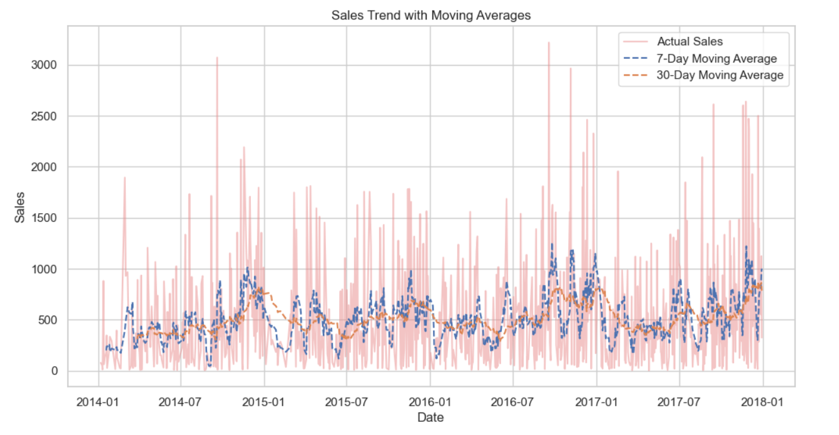

Slide 11
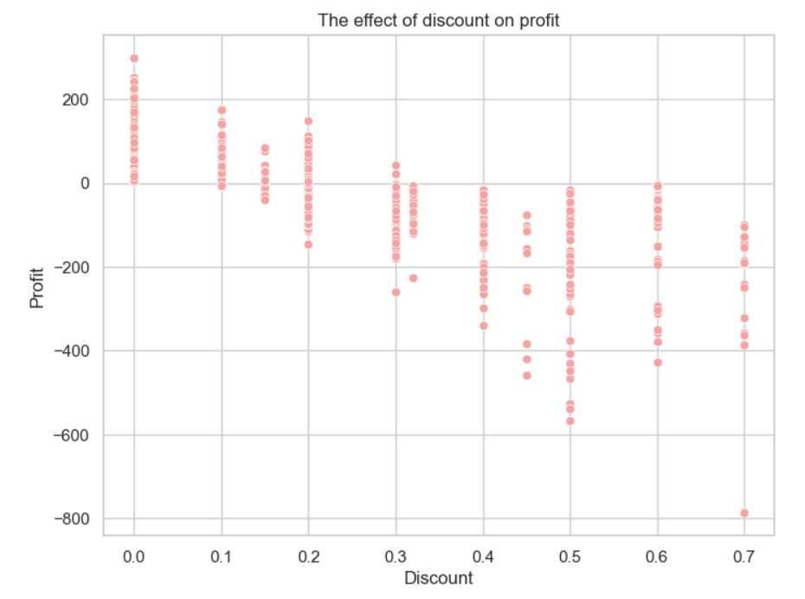
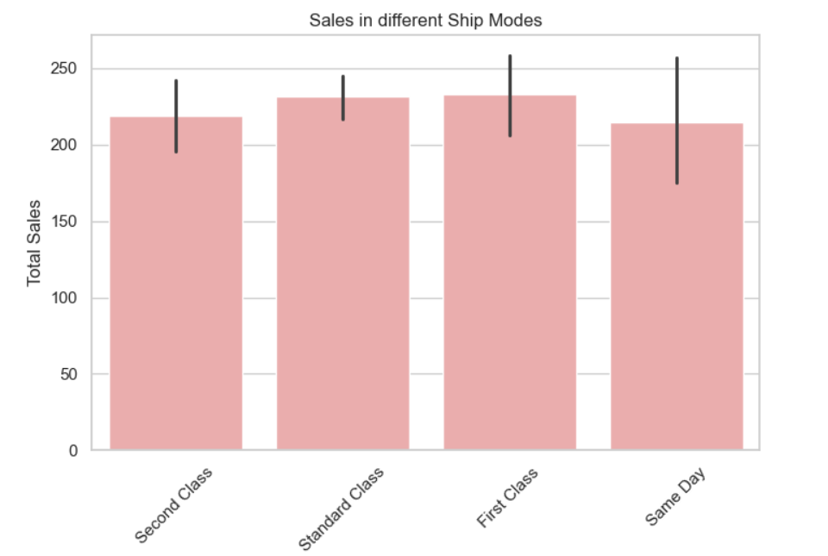
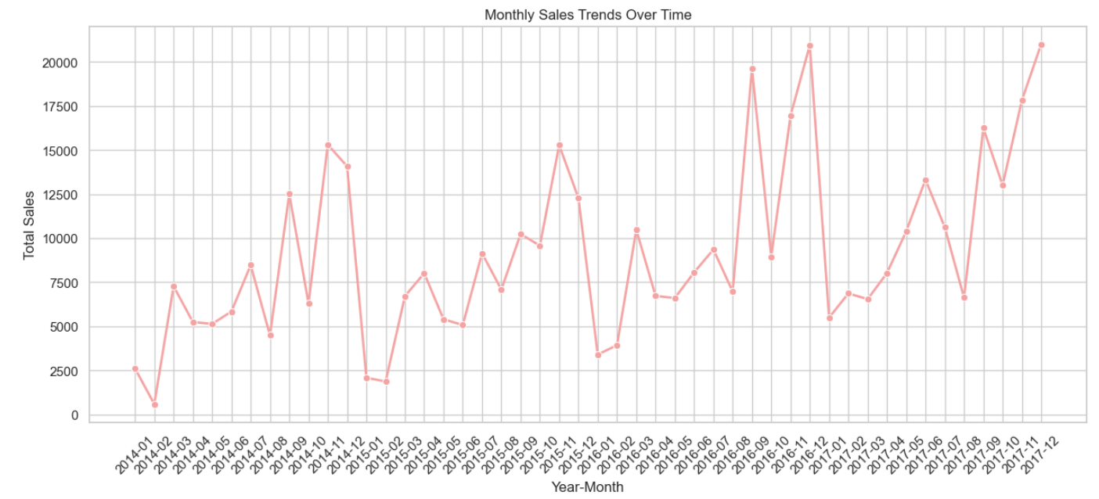

Slide 12

Conclusion: Summary, Recommendations, and Next Steps
Summary
The dataset is complete with no missing values (1798 entries per column).
SQL was used for data extraction, while Python facilitated advanced analysis and visualization.
Insights were drawn on profitability, discount impact, customer segmentation, and regional performance.
Statistical tests and visualizations revealed key sales trends and customer behavior patterns.
Next Steps
After completing exploratory and analytical questions, the next step is to focus on forecasting questions

